Slide 1
Information Security

Slide 2
Security Requirements
Confidentiality
Integrity
Availability

Slide 3
Passive Attacks
Eavesdropping on transmissions
To obtain information
Release of message contents
  Outsider learns content of transmission
Traffic analysis
  By monitoring frequency and length of messages, even encrypted, nature of communication may be guessed
Difficult to detect
Can be prevented

Slide 4
Active Attacks
Masquerade
  Pretending to be a different entity
Replay
Modification of messages
Denial of service
Easy to detect
  Detection may lead to deterrent
Hard to prevent

Slide 5
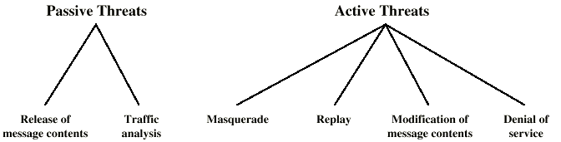
Security Threats

Slide 6
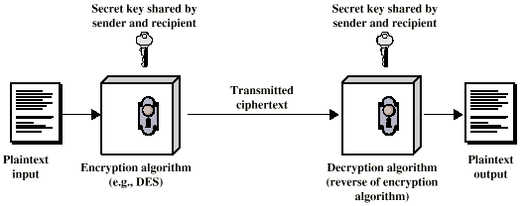
Conventional Encryption

Slide 7
Ingredients
Plain text
Encryption algorithm
Secret key
Cipher text
Decryption algorithm

Slide 8
Requirements for Security
Strong encryption algorithm
  Even if known, should not be able to decrypt or work out key
  Even if a number of cipher texts are available together with plain texts of them
Sender and receiver must obtain secret key securely
Once key is known, all communication using this key is readable

Slide 9
Attacking Encryption
Crypt analysis
  Relay on nature of algorithm plus some knowledge of general characteristics of plain text
  Attempt to deduce plain text or key
Brute force
  Try every possible key until plain text is achieved

Slide 10
Algorithms
Block cipher
  Process plain text in fixed block sizes producing block of cipher text of equal size
  Data encryption standard (DES)
  Triple DES (TDES)

Slide 11
Data Encryption Standard
US standard
64 bit plain text blocks
56 bit key

Slide 12
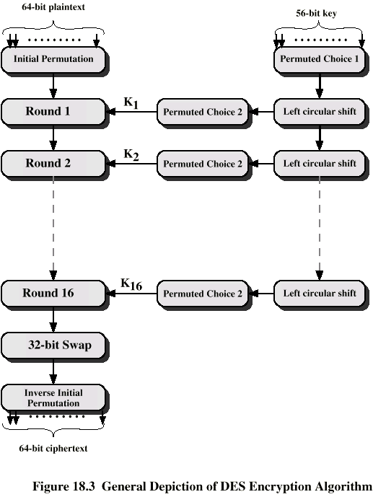
DES
Encryption
Algorithm

Slide 13
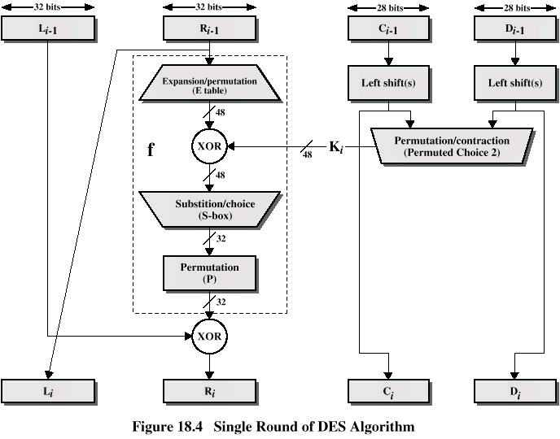
DES Single
Iteration

Slide 14
Strength of DES
Declared insecure in 1998
Electronic Frontier Foundation
DES Cracker machine
DES now worthless
Alternatives include TDEA

Slide 15
Triple DEA
ANSI X9.17 (1985)
Incorporated in DEA standard 1999
Uses 3 keys and 3 executions of DEA algorithm
Effective key length 168 bit

Slide 16
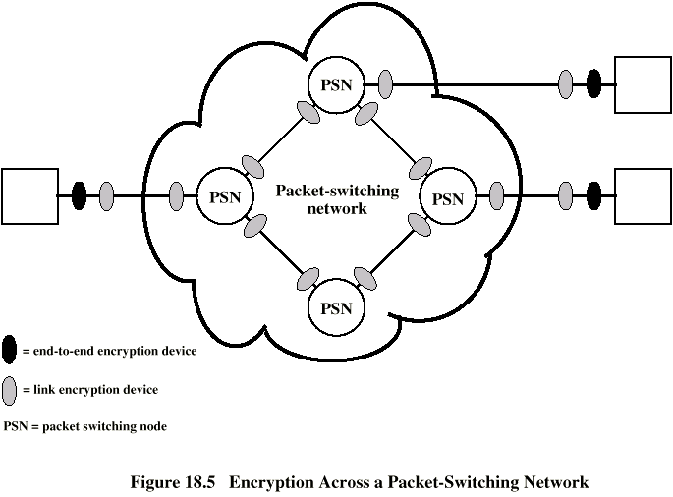
Location of Encryption Devices

Slide 17
Link Encryption
Each communication link equipped at both ends
All traffic secure
High level of security
Requires lots of encryption devices
Message must be decrypted at each switch to read address (virtual circuit number)
Security vulnerable at switches
  Particularly on public switched network

Slide 18
End to End Encryption
Encryption done at ends of system
Data in encrypted form crosses network unaltered
Destination shares key with source to decrypt
Host can only encrypt user data
  Otherwise switching nodes could not read header or route packet
Traffic pattern not secure
Use both link and end to end

Slide 19
Key Distribution
Key selected by A and delivered to B
Third party selects key and delivers to A and B
Use old key to encrypt and transmit new key from A to B
Use old key to transmit new key from third party to A and B

Slide 20
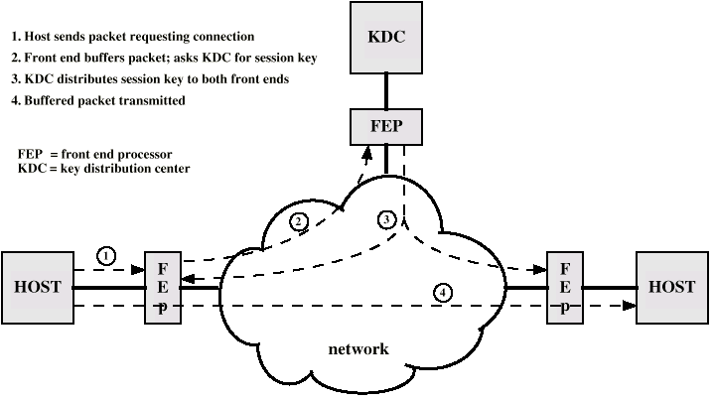
Automatic Key Distribution (diag)

Slide 21
Automatic Key Distribution
Session Key
  Used for duration of one logical connection
  Destroyed at end of session
  Used for user data
Permanent key
  Used for distribution of keys
Key distribution center
  Determines which systems may communicate
  Provides one session key for that connection
Front end processor
  Performs end to end encryption
  Obtains keys for host

Slide 22
Traffic Padding
Produce cipher text continuously
If no plain text to encode, send random data
Make traffic analysis impossible

Slide 23
Message Authentication
Protection against active attacks
  Falsification of data
  Eavesdropping
Message is authentic if it is genuine and comes from the alleged source
Authentication allows receiver to verify that message is authentic
  Message has not altered
  Message is from authentic source
  Message timeline

Slide 24
Authentication Using Encryption
Assumes sender and receiver are only entities that know key
Message includes:
  error detection code
  sequence number
  time stamp

Slide 25
Authentication Without Encryption
Authentication tag generated and appended to each message
Message not encrypted
Useful for:
  Messages broadcast to multiple destinations
    Have one destination responsible for authentication
  One side heavily loaded
    Encryption adds to workload
    Can authenticate random messages
  Programs authenticated without encryption can be executed without decoding

Slide 26
Message Authentication Code
Generate authentication code based on shared key and message
Common key shared between A and B
If only sender and receiver know key and code matches:
  Receiver assured message has not altered
  Receiver assured message is from alleged sender
  If message has sequence number, receiver assured of proper sequence

Slide 27
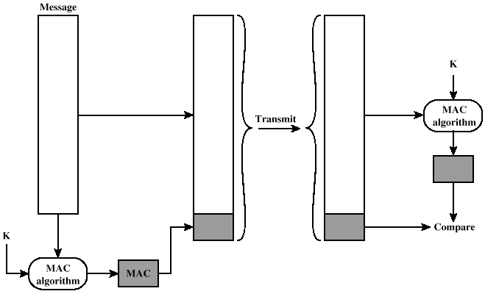
Message Authentication Using Message Authentication Code

Slide 28
One Way Hash Function
Accepts variable size message and produces fixed size tag (message digest)
Advantages of authentication without encryption
  Encryption is slow
  Encryption hardware expensive
  Encryption hardware optimized to large data
  Algorithms covered by patents
  Algorithms subject to export controls (from USA)

Slide 29
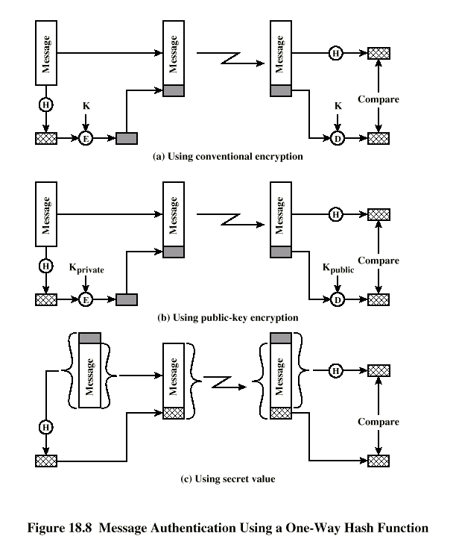
Using
One
Way
Hash

Slide 30
Secure Hash Functions
Hash function must have following properties:
  Can be applied to any size data block
  Produce fixed length output
  Easy to compute
  Not feasible to reverse
  Not feasible to find two message that give the same hash

Slide 31
SHA-1
Secure Hash Algorithm 1
Input message less than 2⁶⁴ bits
  Processed in 512 bit blocks
Output 160 bit digest

Slide 32
Public Key Encryption
Based on mathematical algorithms
Asymmetric
  Use two separate keys
Ingredients
  Plain text
  Encryption algorithm
  Public and private key
  Cipher text
  Decryption algorithm

Slide 33
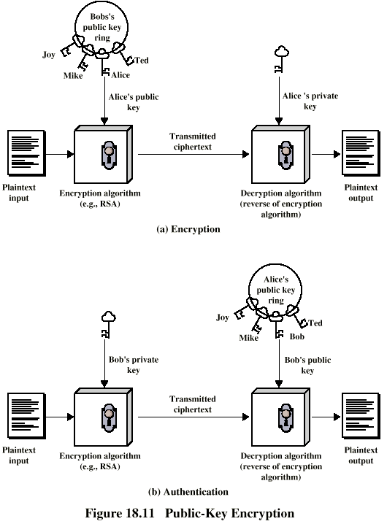
Public Key
Encryption
(diag)

Slide 34
Public Key Encryption - Operation
One key made public
  Used for encryption
Other kept private
  Used for decryption
Infeasible to determine decryption key given encryption key and algorithm
Either key can be used for encryption, the other for decryption

Slide 35
Steps
User generates pair of keys
User places one key in public domain
To send a message to user, encrypt using public key
User decrypts using private key

Slide 36
Digital Signature
Sender encrypts message with their private key
Receiver can decrypt using seneders public key
This authenticates sender, who is only person who has the matching key
Does not give privacy of data
  Decrypt key is public

Slide 37
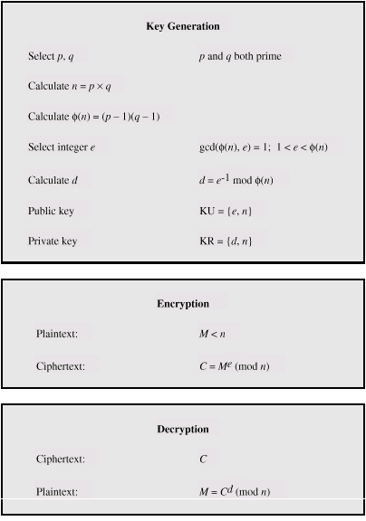
RSA Algorithm

Slide 38
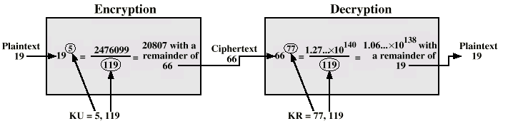
RSA Example

Slide 39
IPv4 and IPv6 Security
IPSec
Secure branch office connectivity over Internet
Secure remote access over Internet
Extranet and intranet connectivity
Enhanced electronic commerce security

Slide 40
IPSec Scope
Authentication header
Encapsulated security payload
Key exchange
RFC 2401,2402,2406,2408

Slide 41
Security Association
One way relationship between sender and receiver
For two way, two associations are required
Three SA identification parameters
  Security parameter index
  IP destination address
  Security protocol identifier

Slide 42
SA Parameters
Sequence number counter
Sequence counter overflow
Anti-reply windows
AH information
ESP information
Lifetime of this association
IPSec protocol mode
  Tunnel, transport or wildcard
Path MTU

Slide 43
Transport and Tunnel Modes
Transport mode
  Protection for upper layer protocols
  Extends to payload of IP packet
  End to end between hosts
Tunnel mode
  Protection for IP packet
  Entire packet treated as payload for outer IP “packet”
  No routers examine inner packet
  May have different source and destination address
  May be implemented at firewall

Slide 44
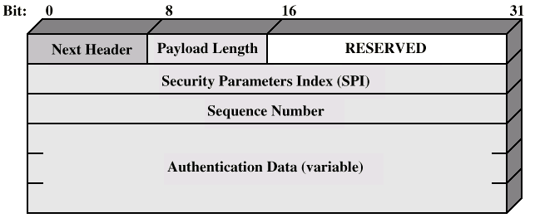
Authentication Header

Slide 45
Encapsulating Security Payload
ESP
Confidentiality services

Slide 46
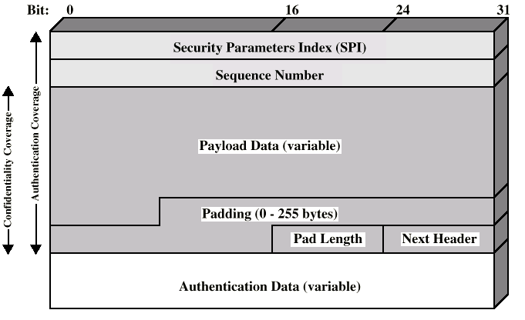
ESP Packet

Slide 47
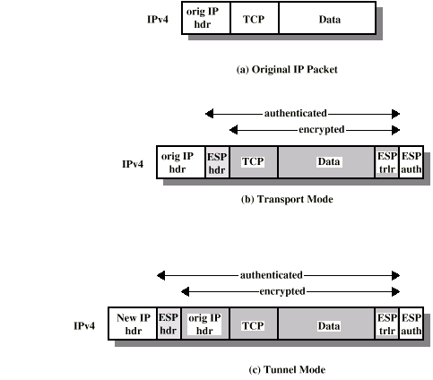
Scope of ESP

Slide 48
Key Management
Manual
Automatic
  ISAKMP/Oakley
    Oakley key determination protocol
    Internet security association and key management protocol

Slide 49
Required Reading
Stallings chapter 18

